Slide 2
It’s time to…
Follow Jesus and in doing so become more like him!
Be imitators of God, therefore, as dearly loved children
and live a life of love, just as Christ loved us and gave himself up for us as a fragrant offering and sacrifice to God. Ephesians 5:1

Slide 3
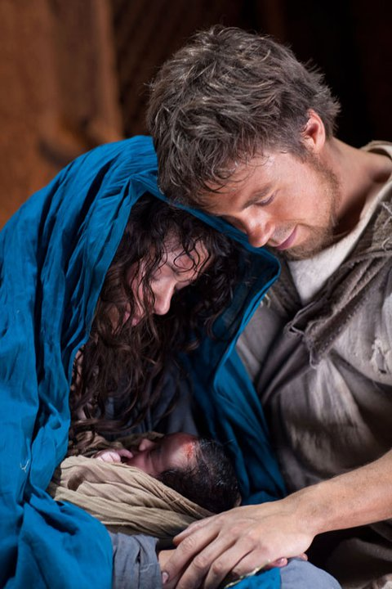
Following Jesus
means accepting his call and the cost
Luke 1:38
“I am the Lord’s servant,” Mary answered. “May your word to me be fulfilled.”

Slide 4
Following Jesus
means accepting his call and the cost
Luke 12:51
And Mary treasured all these things in her heart.

Slide 5
Following Jesus
means accepting his call and the cost
What is God asking of you today, this week, in the big but also the small?

Slide 6
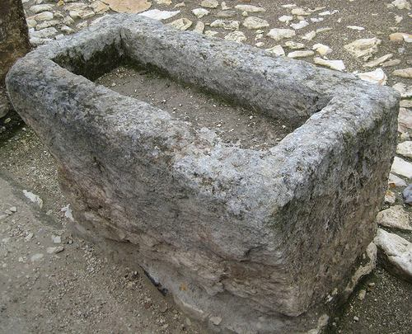
Following Jesus
We come as we are.
Luke 2:6-7
While they were there, the time came for the baby to be born,
and she gave birth to her firstborn, a son. She wrapped him in cloths and placed him in a manger, because there was no room for them in the inn.

Slide 7
Following Jesus
We come as we are.
“The Spirit of the Lord is on me,
because he has anointed me
to proclaim good news to the poor.
He has sent me to proclaim freedom for the prisoners
and recovery of sight for the blind,
to set the oppressed free,
to proclaim the year of the Lord’s favour.” Luke 4:18-19

Slide 8
Following Jesus
We come as we are.
It’s not what I can do for God but what God can do through me!
Mike Breen developing a discipling culture.

Slide 9
Following Jesus
We come as we are.
What can I give him, Poor as I am, if I were a shepherd, I will bring a lamb, If I were a wise man I will do my part,
What can I give him, give my heart.
Christina Rossenli

Slide 10
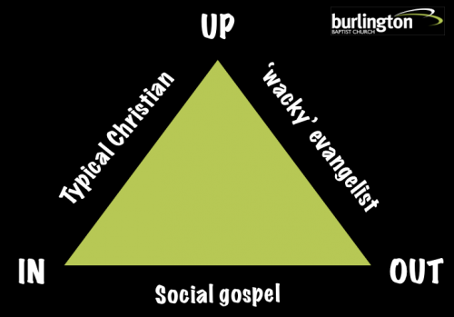
Following Jesus
Going not staying
He came to his own people,
but they didn't want him.
John 1:13 – The Message
.

Slide 11
Following Jesus
Going not staying
The act of Jesus being born shows us that Jesus’ life was motivated by his ‘out’.
Is yours?

Slide 12
Following Jesus
Means being a surprise!
Say Yes
Take the risk
Go as you are
Go
Be a surprise

Slide 13
