Slide 1


Slide 2


Slide 3
The search for identity:
Who am I?
Where do I come from?
Where am I going?
Am I happy?
Do I matter?

Slide 4
“I…beg you to lead a life worthy of your calling, for you have been called by God”
Ephesians 4:1

Slide 5
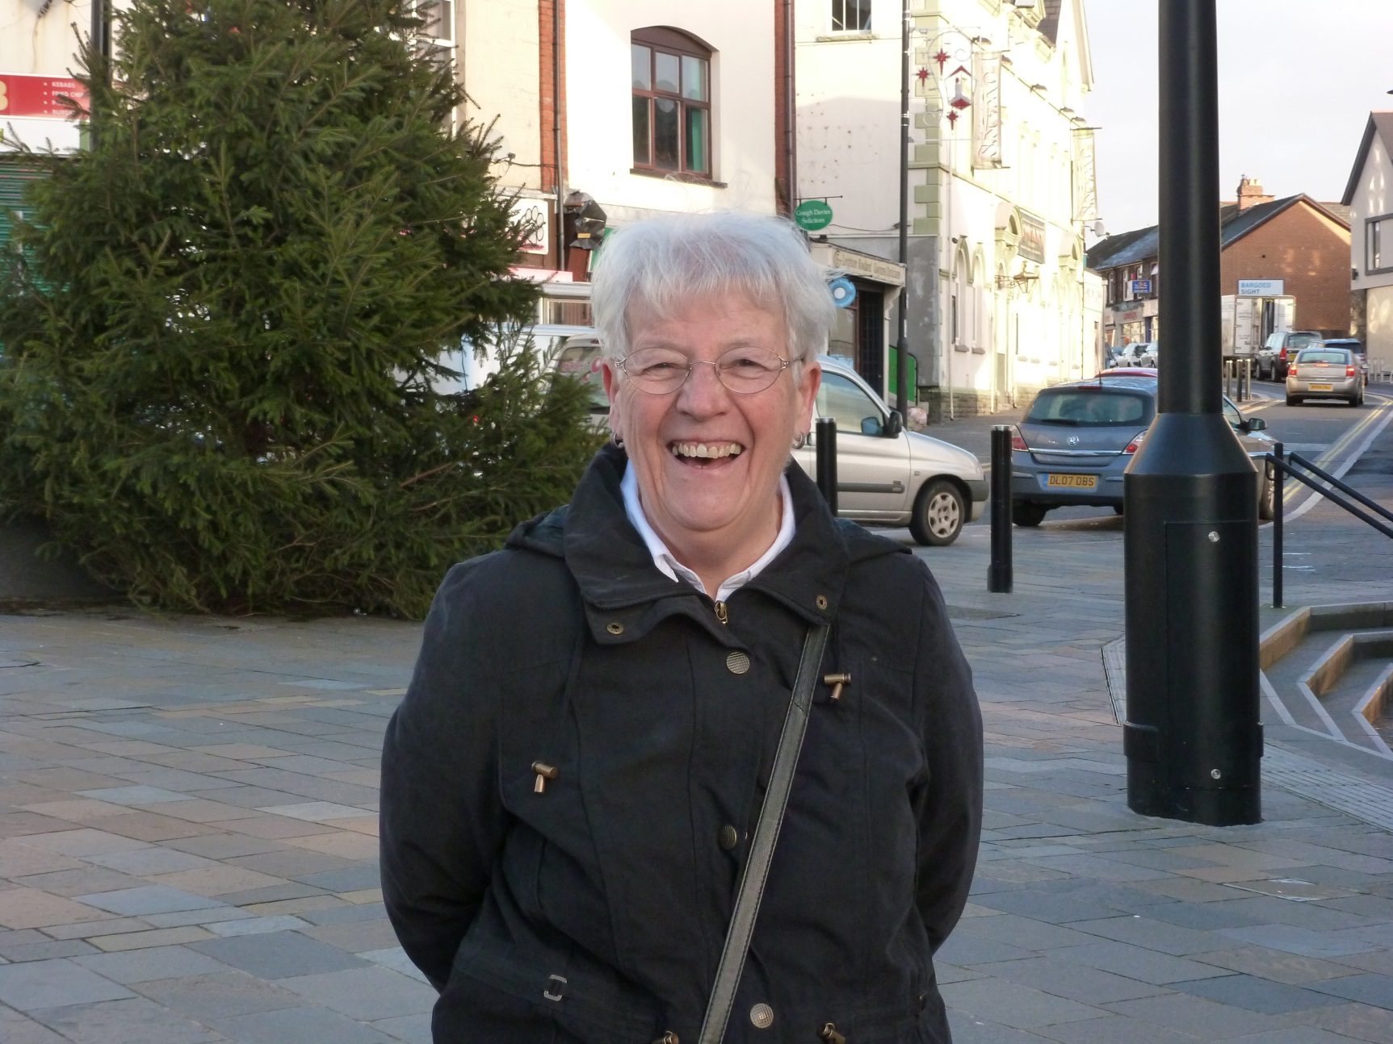
My Mum

Slide 6
Mum’s call always required a response
But…
sometimes I didn’t want to hear it
sometimes I chose to ignore it
mostly I ran towards it

Slide 7
Given Significance
When we were dead, God gave us life
2:1, 5
When we were nobodies, God chose us for a purpose 2:8-10

Slide 8
Discovering Security
We are members of God’s family and God himself lives in us as His holy temple 2:19-22
We have complete access to God, all the time 3:12

Slide 9
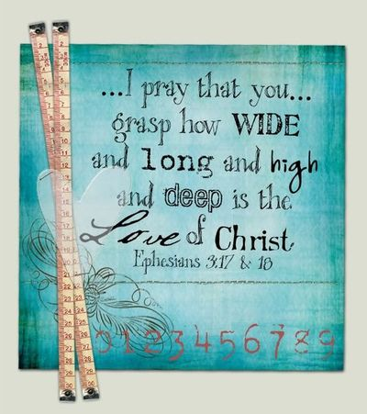
Knowing Satisfaction
From knowing the power of the Spirit and the love of Christ 3:16-19

